Slide 1

VIRTUAL PRIVATE NETWORKS (VPN)
Group of 2c10 class
Nguyen Van Cong
Tran Phi Hung
Dang Thi Duyen
Nguyen Trung Kien
Lai Thi Mai

Slide 2
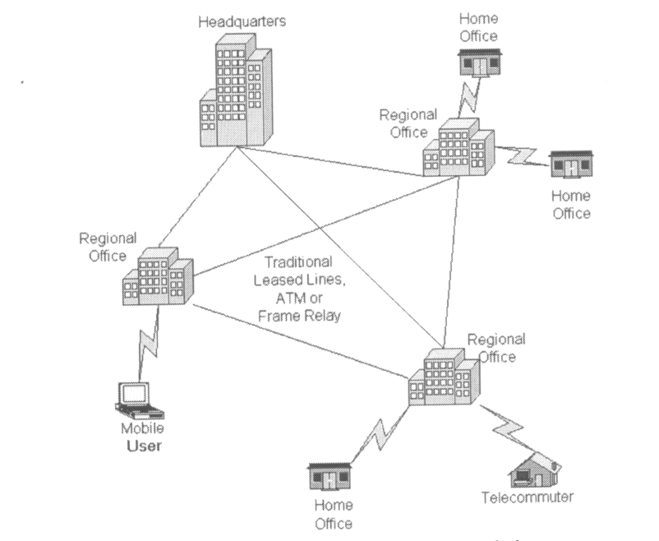
Traditional connectivity

Slide 3
VIRTUAL PRIVATE NETWORKS
1. The definition
2. Why have VPN
3. VPN network protocols
4. Advantages and Disadvantages
5. VPN application ( openVPN )

Slide 4
Definition
The VPN ( Virtual Private Networks) is the secure connection between two or more endpoints. It can also be seen as an extension to a private network.
The are 2 key types of VPN Scenarios :
- Site to site VPN
- Remote access VPN

Slide 5
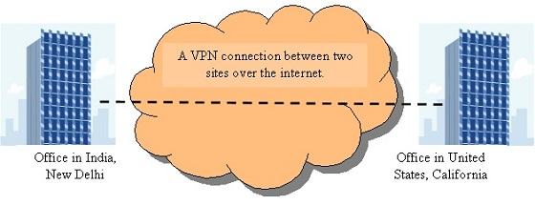
Site to site VPN
In a site to site VPN data is encrypted from one VPN gateway to the other, providing a secure link between two sites over the internet. This would enable both sites to share resources such as documents and other types of data over the VPN link.

Slide 6
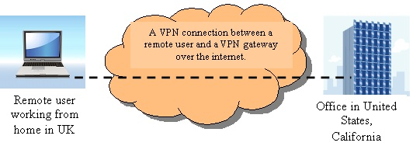
Remote access VPN
In a remote access VPN scenario which is also known as mobile VPN a secure connection would be made from an individual computer to a VPN gateway. This would enable a user to access their e-mail, files and other resources at work from where ever they may be, providing they have an internet connection.

Slide 7
Why have VPN
A VPN saves organisations \ companies from renting expensive dedicated leased lines, VPN's give the ability for users to work from home and saves cost on resources
VPN’s provide a superb and cost effective solution for companies with several branch offices, partners, and remote users to share data and connect to their corporate network in a secure and private manner.
all data packets providing high level of security. If packets which were sent securely over the internet were sniffed, they would be unreadable and if modified this would also be detected by the VPN gateway.

Slide 8
VPN Networking protocols
PPTP -- Point-to-Point Tunneling Protocol
L2TP -- Layer 2 Tunneling Protocol
IPsec -- Internet Protocol Security
SSL VPN (Secure Socket Layer)

Slide 9
PPTP -- Point-to-Point Tunneling Protocol
PPTP is a protocol or technology that supports the use of VPN’s. Using PPTP, remote users can access their corporate networks securely using the Microsoft Windows Platforms and other PPP (Point to Point tunneling Protocols) enabled systems. This is achieved with remote users dialing into their local internet security providers to connect securely to their networks via the internet.
PPTP has its issues and is considered as a weak security protocol according to many experts, although Microsoft continues to improve the use of PPTP and claims issues within PPTP have now been corrected. Although PPTP is easier to use and configure than IPSec, IPSec outweighs PPTP in other areas such as being more secure and a robust protocol.

Slide 10
L2TP -- Layer 2 Tunneling Protocol
L2TP is an extension of the PPTP (Point to point tunneling protocol), used by internet service providers to provide VPN services over the internet. L2TP combines the functionality of PPTP and L2F (Layer 2 forwarding protocol) with some additional functions using some of the IPSec functionality. Also L2TP can be used in conjunction with IPSec to provide encryption, authentication and integrity. IPSec is the way forward and is considered better than the layer 2 VPN’s such as PPTP and L2TP.

Slide 11
IPsec -- Internet Protocol Security
IPSec operates on layer 3 and so can protect any protocol that runs on top of IP. IPSec is a framework consisting of various protocols and algorithms which can be added to and developed. IPSec provides flexibility and strength in depth, and is an almost perfect solution for securing VPN’s. The only drawback is IPSec requires setting up on the corporate network and on the client end and is a complex framework to work with. IPSec is used for both site to site and remote user connectivity.

Slide 12
SSL VPN (Secure Socket Layer)
SSL VPN provides excellent security for remote access users as well as ease of use. SSL is already heavily used such as when you shop online, accessing your bank account online, you will notice an SSL protected page when you see the “https” in your browser URL bar as opposed to “http”.
The difference in using SSL VPN to IPSec is with IPSec a remote user would require client software which would need installing, configuring and sometimes troubleshooting. However with SSL there is no client software if a user was using the SSL portal. The portal is a GUI interface that is accessed via a web browser and contains tools and utilities in order to access applications on the network such as RDP and Outlook. SSL can also imitate the way IPSec works via a lightweight software. If a user required client SSL software, it can be installed with very little effort via a browser which simplifies the process in securely accessing to the corporate network.
Using SSL VPN would mean thousands of end user’s would be able to access the corporate network without the support of an administrator and possible hours of configuring and trouble shooting, unlike IPSec. The end user would just need to know the address of the SSL VPN portal. Another advantage is they can do this from any computer as they do not have to rely on a configured client side software.

